Slide 1
CS 4530 Fundamentals of Software Engineering
Lecture 12.2: Ethics in Software Engineering
Jonathan Bell, Adeel Bhutta, Ferdinand Vesely, Mitch Wand
Khoury College of Computer Sciences
© 2022, released under CC BY-SA

Slide 2
Learning Objectives for this Lesson
By the end of this lesson, you should be able to…
Explain several of the meanings of “the public interest”.
List some sources of ethical guidance for a software engineer.
List several things that a software engineer can do to try to behave in an ethical manner.

Slide 3
Professional Ethics
Professional standards
By 1675, standards established for: divinity, law, medicine
Professionals exercise specialist knowledge or skill - professional ethics governs how this knowledge should be governed
12th-century Byzantine manuscript of the Hippocratic Oath
Notes:
Before getting into ethics for software engineering, it’s useful to think about the origins of professional ethics. “Professionals” in this context generally refers to individuals who exercise some special knowledge that the public-at-large does not hold. When a professional provides services to a layperson, it is important for that layperson to be able to trust that they are not being taken advantage of. For example, the earliest instance of professional ethics is likely the hippocratic oath, which is rooted in doing no harm. Professional ethics standards exist for many different professions.

Slide 4
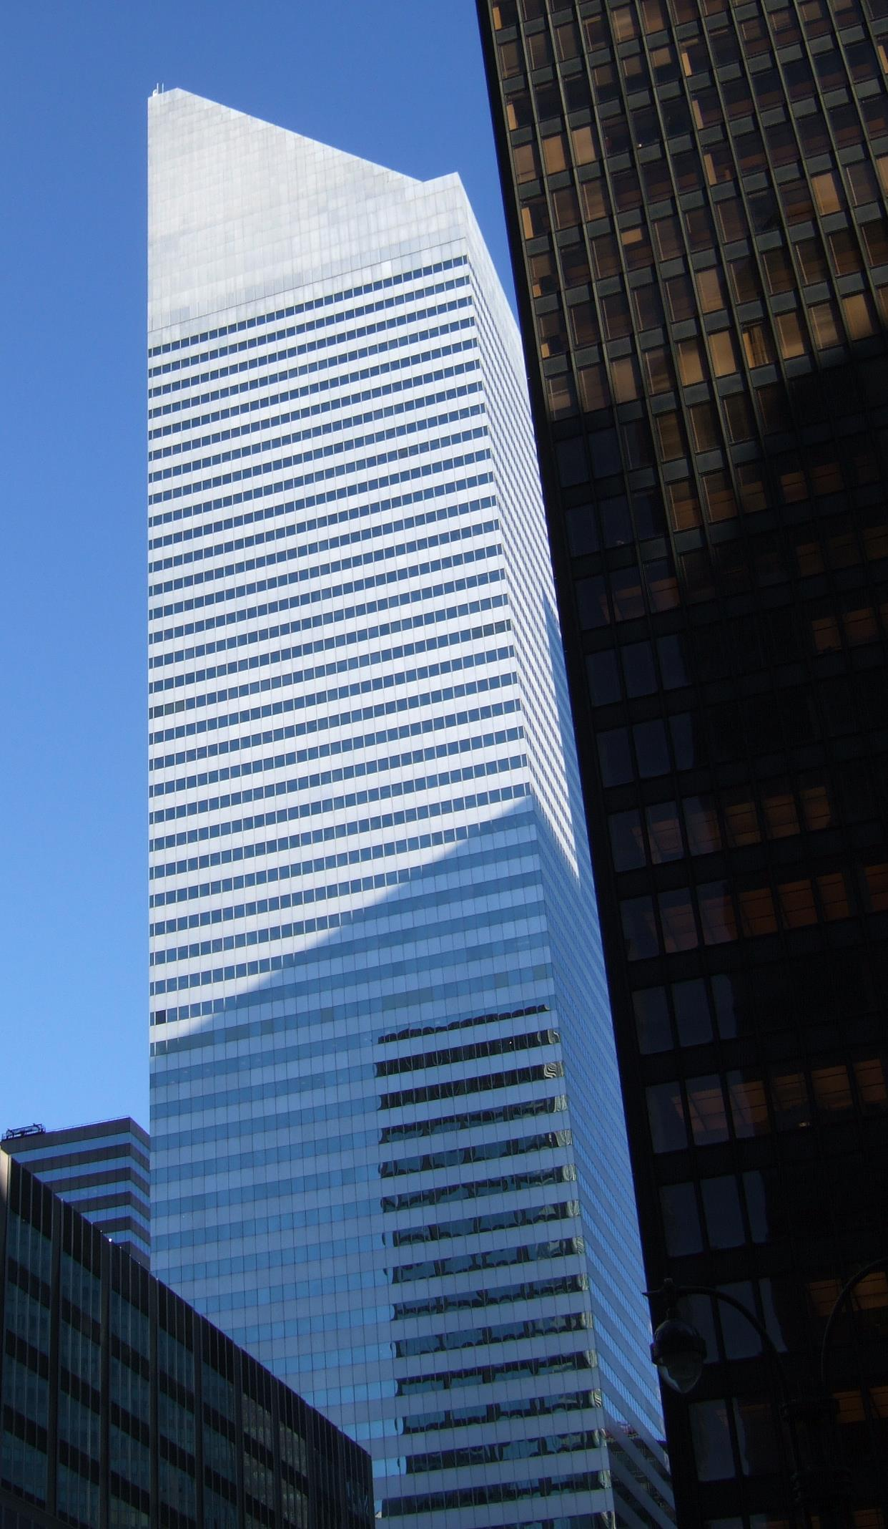
Code of Ethics
Professional Engineers
Engineers, in the fulfillment of their professional duties, shall:
Hold paramount the safety, health, and welfare of the public.
Perform services only in areas of their competence.
Issue public statements only in an objective and truthful manner.
Act for each employer or client as faithful agents or trustees.
Avoid deceptive acts.
Conduct themselves honorably, responsibly, ethically, and lawfully so as to enhance the honor, reputation, and usefulness of the profession.
National Society of Professional Engineers - Code of Ethics for Engineers
Notes:
Given that we’re talking about SOFTWARE engineering, it’s particularly useful to consider the closely related ethical problems that arise in civil engineering. Whereas it might be difficult to identify an immediate risk to life from a failure of most software, it is much easier to see how a miscalculation in the design of a building could result in the building to collapse, which would be catastrophic. Professional engineers are required to receive significant training in ethics to ensure that they understand the importance of, above all, ensuring the safety, health and welfare of the public. The building shown on this slide, the Citigroup tower in new york city, provides a particularly interesting case study of ethics in engineering.

Slide 5
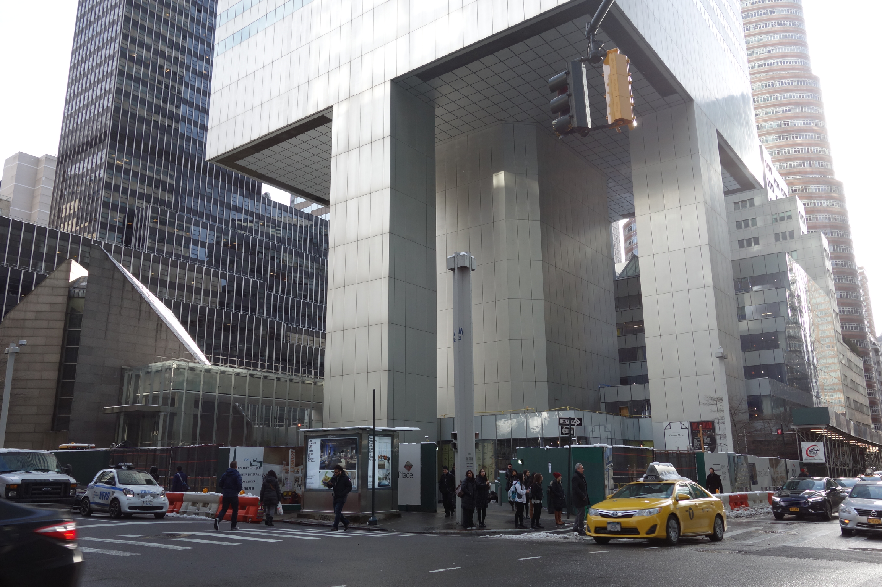
Code of Ethics
Professional Engineers: Citigroup Center
Design met building code, but did not account for all failure modes
Last-minute changes to construction increased odds of failure
Fixed before disaster could strike, but kept a secret for 20 years
https://www.theaiatrust.com/whitepapers/ethics/study.php
“Citigroup Center” by Tdorante10, Wikimedia commons, CC BY-SA 4.0
Notes:
Here’s a photo of the bottom of Citigroup Center, which was built 1974. It’s a very interesting building design: a 59 story tower cantilevered over a church - note this unique column architecture supporting the building. The engineer, LeMessurier, created a design that met building code (which in particular, required the design to be resilient to winds from N/S/E/W), but an analysis by an undergrad’s senior thesis found a diagonal hurricane-force wind would quite likely blow over the building. Usually face-on winds are the worst (for a building with columns on corners), but this building had columns in middle! Would have been OK if bottom joints were welded, but steel contractor wanted to bolt them to save millions of dollars, and was OKed. Fixed by the engineering firm, quite quickly, but also quietly. While being fixed added extra precautions to ensure safety and monitor weather, with evacuation plans. Kept secret for 20 years! This is a very interesting case study: note that the engineer did follow regulations, but still did not ensure safety in their design. Thankfully, the flaw was found by the student, and the engineering firm quickly took action to repair it, taking responsibility for the problem. One interesting discussion point here, however, is regarding how it was repaired - in secret! Do you think that this design flaw should have been made immediately public?

Slide 6
Badly-engineered software can kill people
Therac-25 (1985-1987)
Bug in software caused 100x greater exposure to radiation than intended
At least 6 died
Likely far more suffered: deaths occurred over a period of 2 years!
Weak accountability in manufacturer’s organization
“Therac-25” by Catalina Márquez, Wikimedia commons, CC BY-SA 4.0
https://ethicsunwrapped.utexas.edu/case-study/therac-25
Notes:
In contrast to the Citigroup tower case, where the engineering firm took responsibility for the failure and rectified it, let’s consider another classic professional ethics case, this one, from software engineering. A bug in the software controlling the THERAC-25 radiation treatment machine resulted in the death of at least 6 patients, and administered countless additional overdoses. Investigations after-the-fact found that the manufacturer had extremely poor software development and quality assurance processes, without independent code review, without testing, and without safety checks. The machine operators were assured that overdoses were impossible - software was reused from older machines which had hardware interlocks to prevent these software defects from being catastrophic. Note that one result of this incident is stronger standards for safety-critical (in particular: medical) software, which now require rigorous quality assurance practices. The manufacturer of the machine, however, could have easily prevented further damage had they immediately detected and resolved the bug after the first reported incident in 1985.

Slide 7
Code of Ethics
ACM’s Code of Ethics Software Engineers
1. PUBLIC – Software engineers shall act consistently with the public interest.
2. CLIENT AND EMPLOYER – Software engineers shall act in a manner that is in the best interests of their client and employer consistent with the public interest.
3. PRODUCT – Software engineers shall ensure that their products and related modifications meet the highest professional standards possible.
4. JUDGMENT – Software engineers shall maintain integrity and independence in their professional judgment.
5. MANAGEMENT – Software engineering managers and leaders shall subscribe to and promote an ethical approach to the management of software development and maintenance.
6. PROFESSION – Software engineers shall advance the integrity and reputation of the profession consistent with the public interest.
7. COLLEAGUES – Software engineers shall be fair to and supportive of their colleagues.
8. SELF – Software engineers shall participate in lifelong learning regarding the practice of their profession and shall promote an ethical approach to the practice of the profession.
1. PUBLIC – Software engineers shall act consistently with the public interest.
https://ethics.acm.org/code-of-ethics/software-engineering-code/
Notes:
Software Engineers are not legally held to any code of ethics, and unlike many other professionals (like lawyers, doctors, and civil engineers), we are not licensed by a professional society who holds us to ethical standards. Nonetheless, the ACM, one of the largest professional societies for computer scientists, has established a code of ethics for software engineers. This code is quite similar to those for professional engineers, and includes as the first tenet, (click) that software engineers should act consistently with the public interest - both doing no harm to the public, and hopefully doing good.

Slide 8
Unpacking “Public Interest”
1. PUBLIC – Software engineers shall act consistently with the public interest.
Do no harm: how can our software cause harm?
How can my software fail? What are the implications of that failure?
Who will use my software, and how might different users use it differently?
How will my software impact those who do not use it directly?
Will my software amplify negative behavior for users and society at large?
Notes:
So, when considering that we want to do no harm to the public interest, we might consider asking ourselves questions like this:
If there’s a bug in my software, what could be the resulting impact? What parts of my software will be most likely to have negative human impacts if buggy, and how do we test that part most effectively?
Who will be the users of my software, and will it impact different users in different ways? Will my software disadvantage some users?
Will there be a negative impact on people who do NOT use my software, for instance through climate, or through social forces?

Slide 9
Unpacking “Public Interest”
How can our software make a positive contribution?
Can my software make people’s jobs easier?
Can my software make people happier?
Can my software amplify positive behavior for users and society at large?
How can my software better achieve these goals?
Notes:
Similarly, when we are trying to become excited about some software project and its potential for good, we might think about the potential for our software to make people’s jobs easier and make people happier, broadly amplifying positive behavior for our users and the general public.
If we identify these goals, we can evaluate them as part of our software quality process

Slide 10
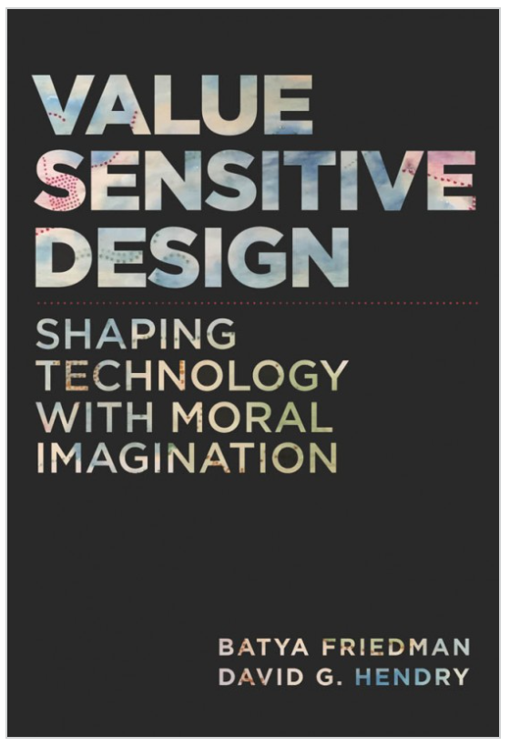
Unpacking “Public Interest”
What values might our software promote or diminish?
Human rights - Inalienable, fundamental rights to which all people are entitled
Accessibility - Making all people successful users of the technology
Justice - Procedural justice (process is fair) + distributive justice (outcomes are fair)
Privacy - An individual’s agency in determining what information about them is shared
Human welfare - Physical, material and psychological well-being
Value Sensitive Design @ Khoury
Notes:
Value-sensitive design is an approach to guide the design of technology while considering the impact of the technology on a variety of core human values. This approach can help us to identify unintended consequences of our software, which we can then begin to reason about.
Core values include human rights, accessibility, justice, privacy and human welfare, and many others.
As we think about the software that we’re building, we can ask ourselves explicitly: how does our software impact these values?

Slide 11
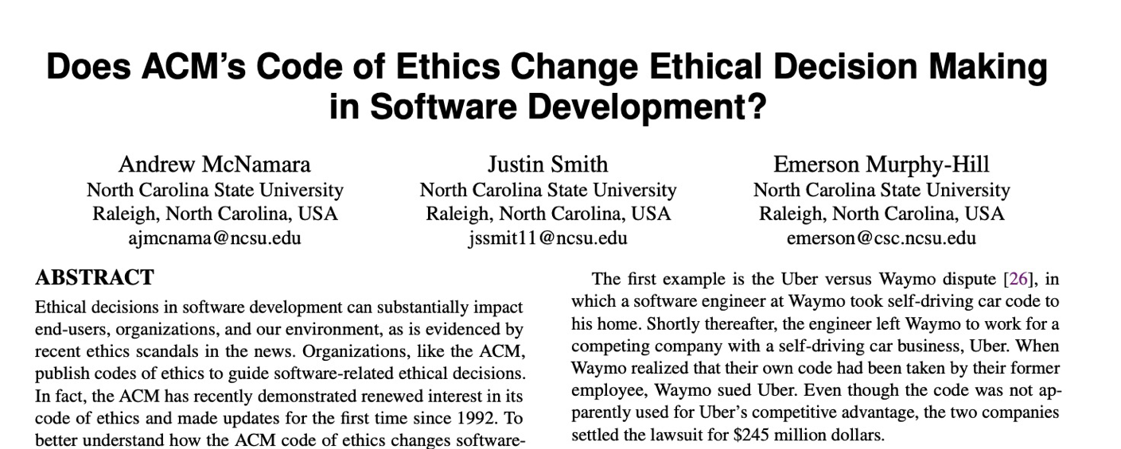
Code of Ethics
ACM’s Code of Ethics Software Engineers
TLDR: No
1. PUBLIC – Software engineers shall act consistently with the public interest.
2. CLIENT AND EMPLOYER – Software engineers shall act in a manner that is in the best interests of their client and employer consistent with the public interest.
3. PRODUCT – Software engineers shall ensure that their products and related modifications meet the highest professional standards possible.
4. JUDGMENT – Software engineers shall maintain integrity and independence in their professional judgment.
5. MANAGEMENT – Software engineering managers and leaders shall subscribe to and promote an ethical approach to the management of software development and maintenance.
6. PROFESSION – Software engineers shall advance the integrity and reputation of the profession consistent with the public interest.
7. COLLEAGUES – Software engineers shall be fair to and supportive of their colleagues.
8. SELF – Software engineers shall participate in lifelong learning regarding the practice of their profession and shall promote an ethical approach to the practice of the profession.
1. PUBLIC – Software engineers shall act consistently with the public interest.
https://ethics.acm.org/code-of-ethics/software-engineering-code/
Notes:
Studies have investigated whether simply exposing engineers to this code of ethics improves ethical decision making in software development
(Click)
(click),
concluding that this code alone does not improve ethical decision making.
Ethical decisions often involve weighing multiple trade-offs: in the case of the Citigroup tower, the engineering firm (and their client, and their insurer) had to make a difficult ethical choice: should they immediately publicly disclose the fact that a strong wind could topple the tower - clearly a concern in the public interest, or should they instead prepare with officials to perform an emergency evacuation and monitor the weather closely without informing the public about the potential hazard (which could provoke unnecessary panic)? A code of ethics alone does not give sufficient guidance.

Slide 12

Standards can give more concrete guidance.
International bodies define standard processes that are designed to protect the public
By (correctly) following such a standard, you can reduce the chance of harm to users, as well as your ethical (and legal) liability
Notes:
Areas where there are well-defined standards give the engineer more concrete guidance. For example, companies constructing medical device software must now comply with well-defined standard processes for developing that software in a way that will assure safety. Simply following the standard doesn’t guarantee safety, but doing so can help to ensure that it does, while also reducing our legal and moral liabilities.

Slide 13
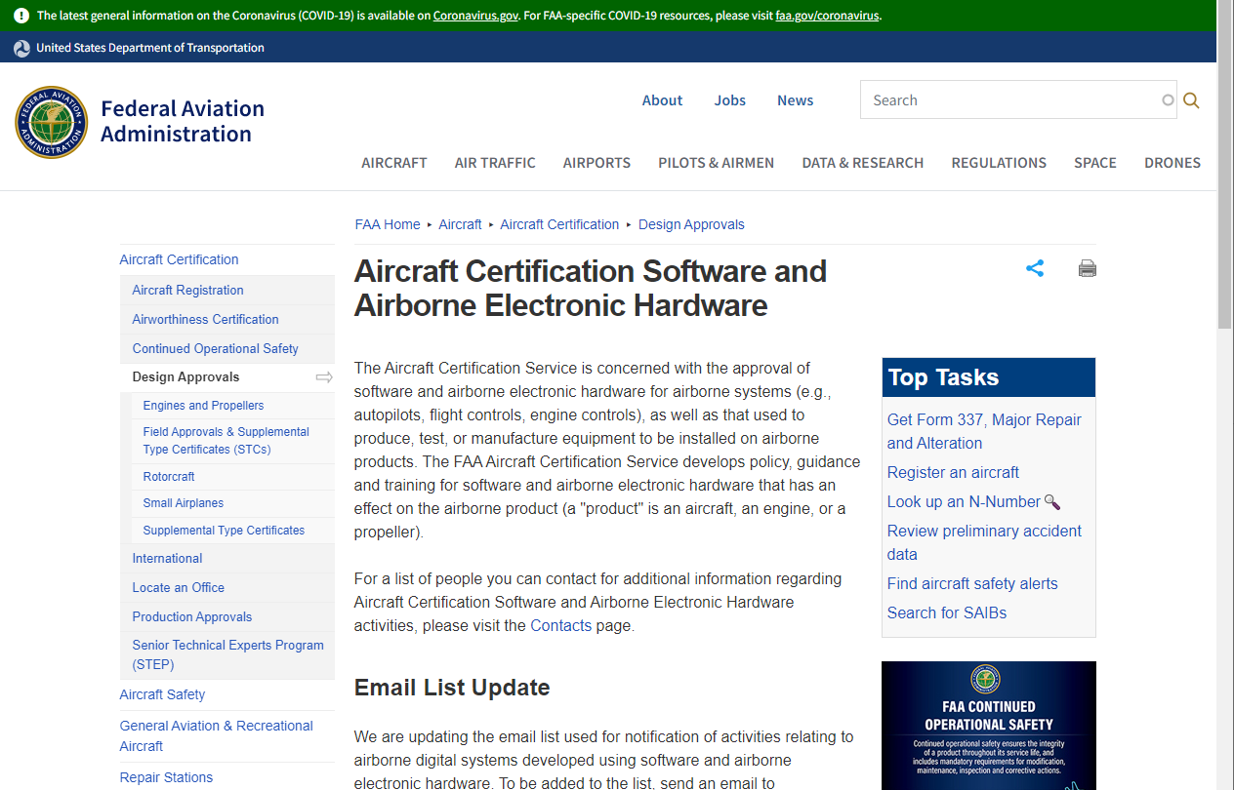
Standards can give more concrete guidance.
Notes:
Similarly, aircraft software must follow a rigorous certification process.

Slide 14
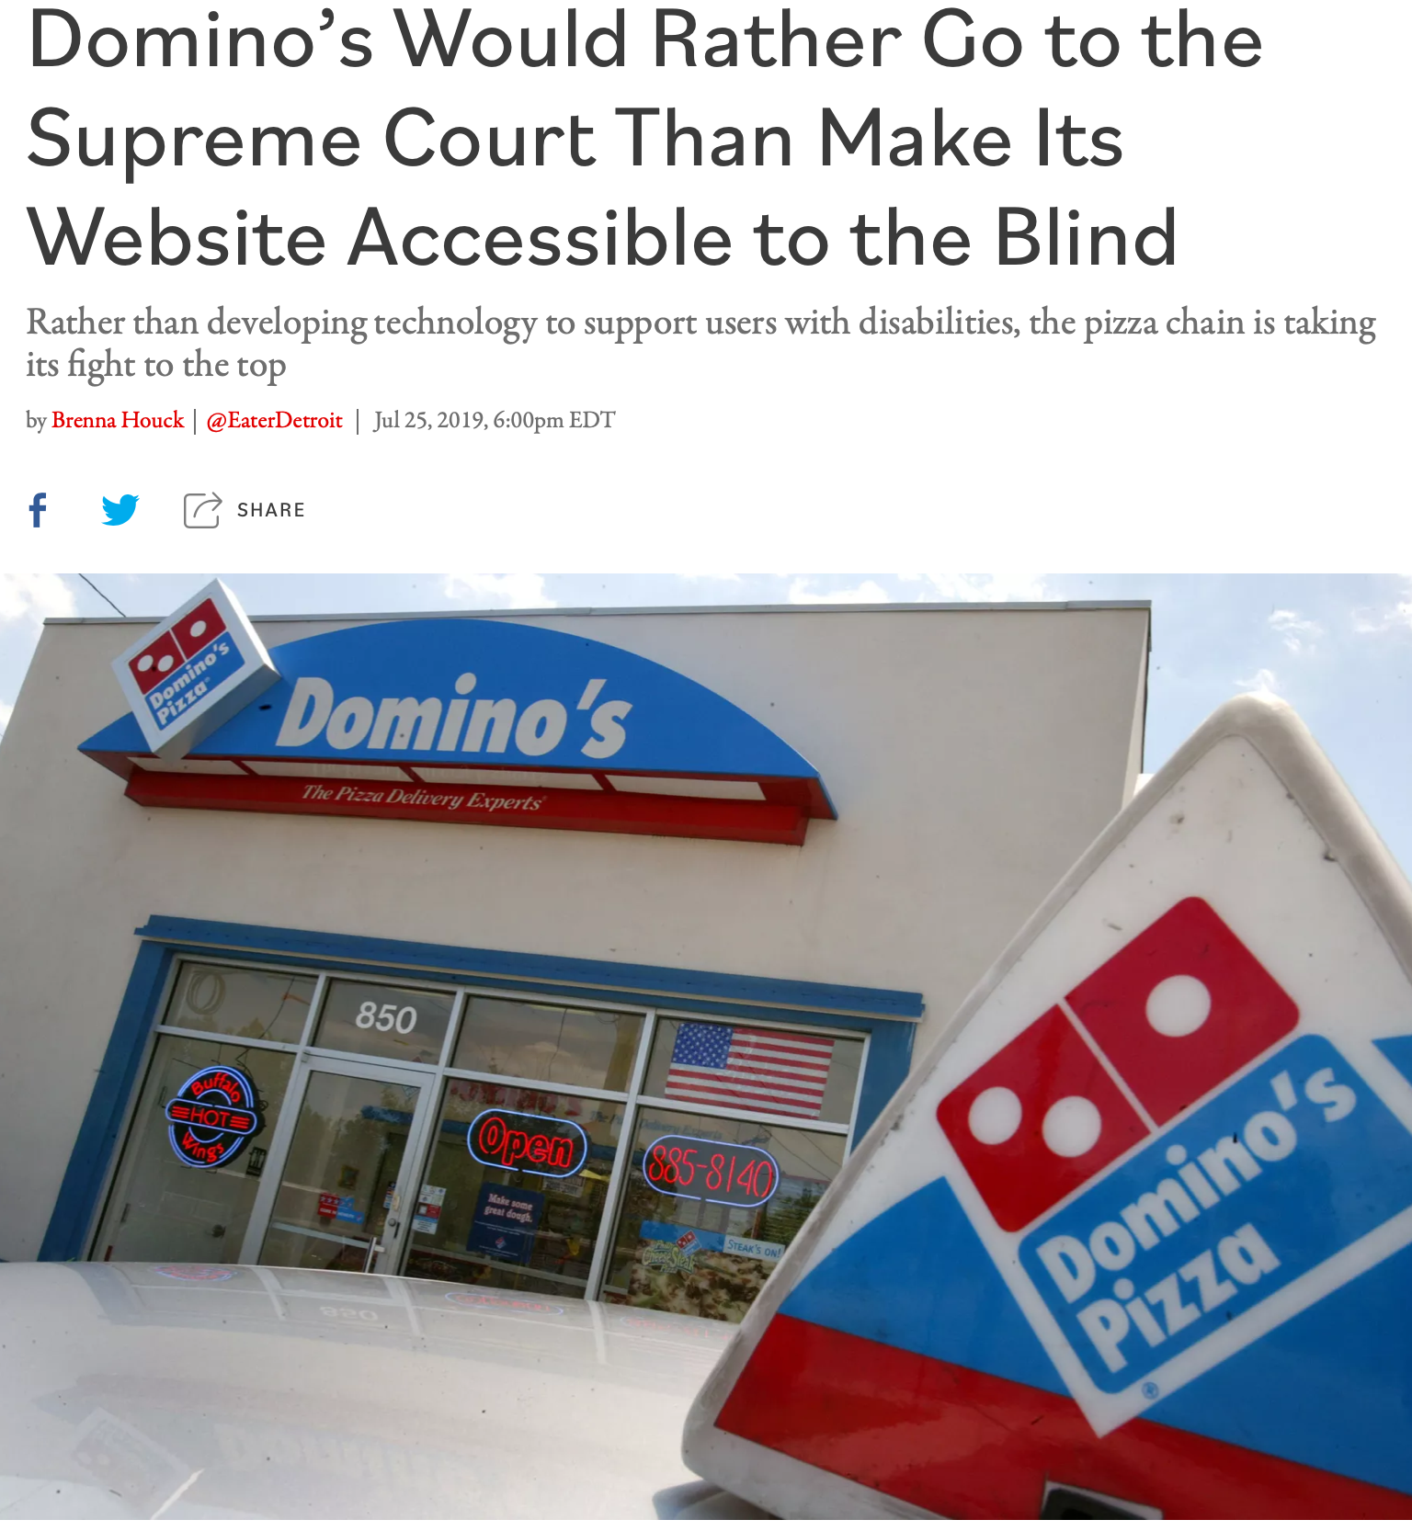
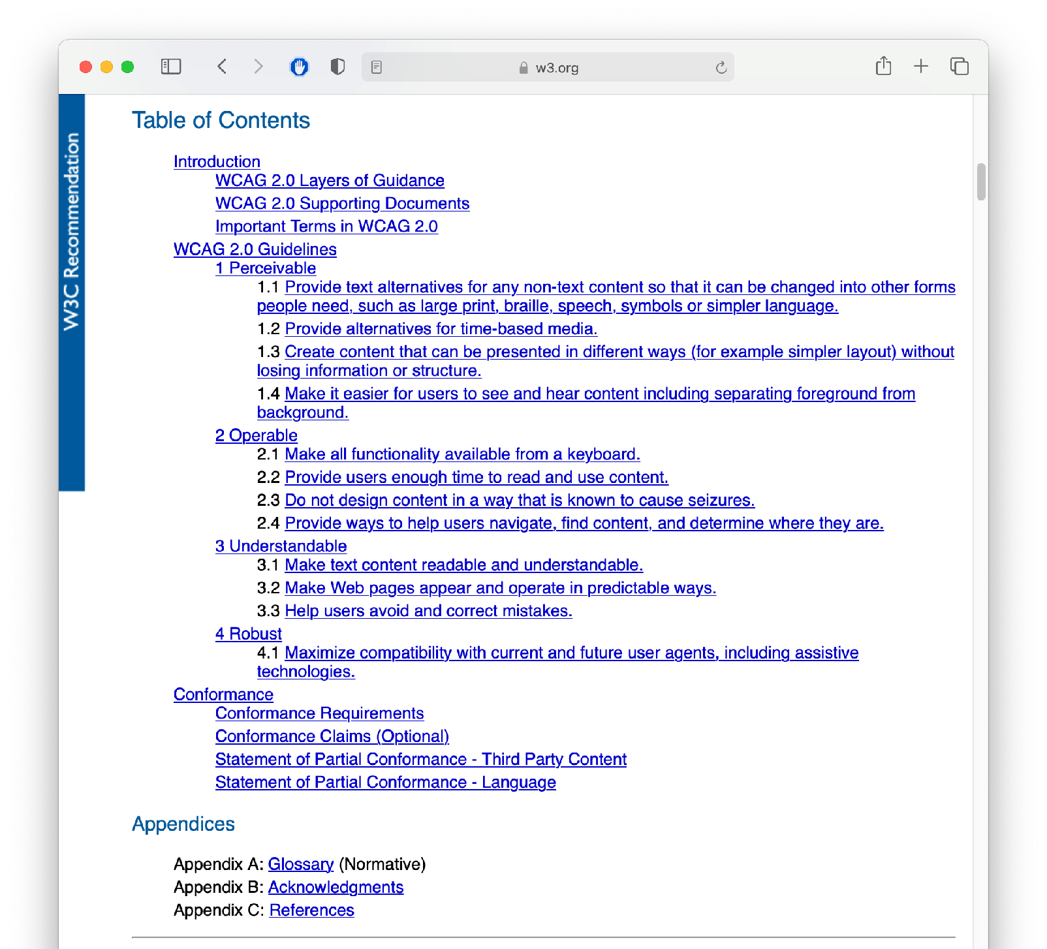
Standards can give more concrete guidance.
Example: Domino’s + ADA
WCAG 2.0 Spe
cification
Notes:
For example, in the case of Domino’s unwillingness to comply with the ADA, there was a standard that could have been followed: the Web Content Accessibility Guidelines (WCAG), which date from 2008– over a decade before the suit.
In court documents, Domino’s revealed it would have cost just $38,000 to resolve the raised accessibility issue

Slide 15
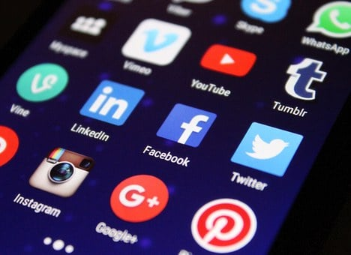
But many ethical decisions are still hard
Example: Social Media Platforms
Social media platforms like Facebook, Twitter, or Tiktok can
Build communities across distance
Spread information for social action
Spread misinformation and disinformation
Amplify hate speech
How to balance freedom vs regulation?

Slide 16
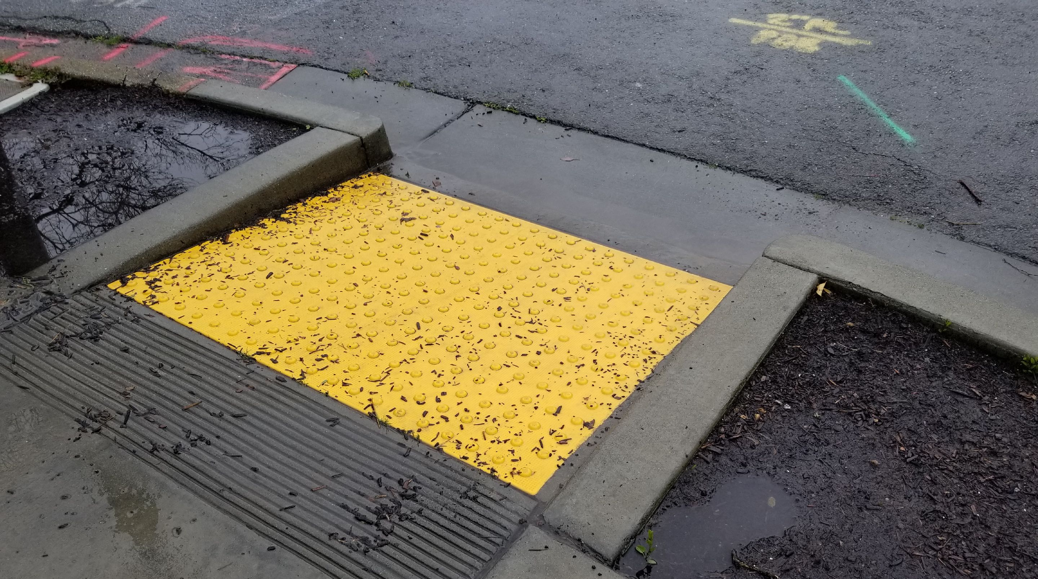
The Curb Cut Effect
“Curb Cuts” by Mike Gifford, CC BY-NC 2.0
Notes:
“The curb cut effect” describes broadly what happens when an inclusive design, built for one audience, benefits everyone. The effect gets its name from curb cuts - the small ramps between sidewalks and streets that were originally designed to allow people in wheelchairs to cross the street. However, this also benefits the old (who might struggle with a step), parents with strollers and workers making deliveries on hand trucks. For Example: Risk averse persona. Imagine that you are sloppy with vocabulary. “Browse off” vs “view map”. This is confusing. This is somethign that the risk averse individual might say “Wait what am I doing? I thought I was looking for a map. Oh I guess it’s turning off the browse feature?” This is like curb cuts though - it helps everyone, since, even if you weren’t particularly confused, it’s still a bit of a road bump.

Slide 17
Where does this leave us?
So that we can sleep at night
Consider the different ways that our software may impact others
Consider the ways in which our software interacts with the political, social, and economic systems in which we and our users live
Follow best practices, and actively push to improve them
Encourage diversity in our development teams
Engage in honest conversations with our co-workers and supervisors to explore possible ethical issues and their implications.
Notes:
There’s no silver bullet for ethical software development. However, hopefully now you understand better the different ways that our software can have impacts on others, and how we can reason about those implications. The next and final lesson in this module will examine how we can better understand our users, so that we can make the best, most inclusive software, and in turn, hopefully cause the least unintended harm.

Slide 18
Learning Objectives for this Lesson
You should now be able to:
Explain several of the meanings of “the public interest”.
List some sources of ethical guidance for a software engineer.
List several things that a software engineer can do to try to behave in an ethical manner.

